Slide 1
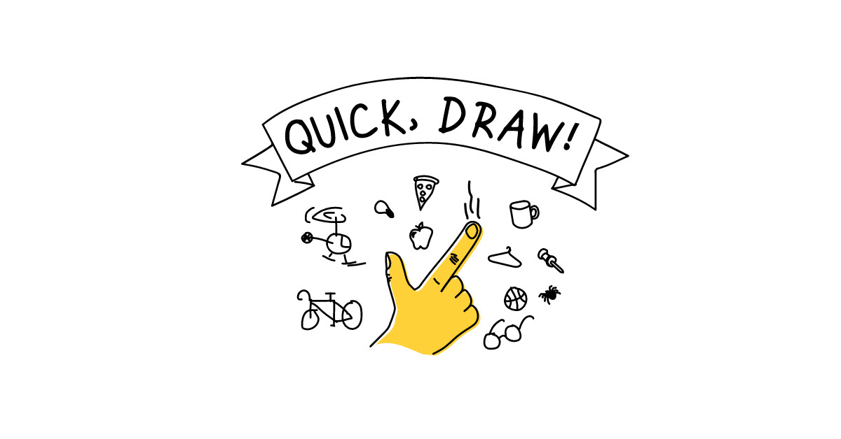
Quick Draw Recognition
Class: VTC - Foundation 7
Lecturer: Mr. Hưng Ngô
Final Project
Le Hung Son

Slide 2
Overviews
Introduction
TEFPA
Dataset
Model
Training History
Demo
Q & A
Project summary
References

Slide 3
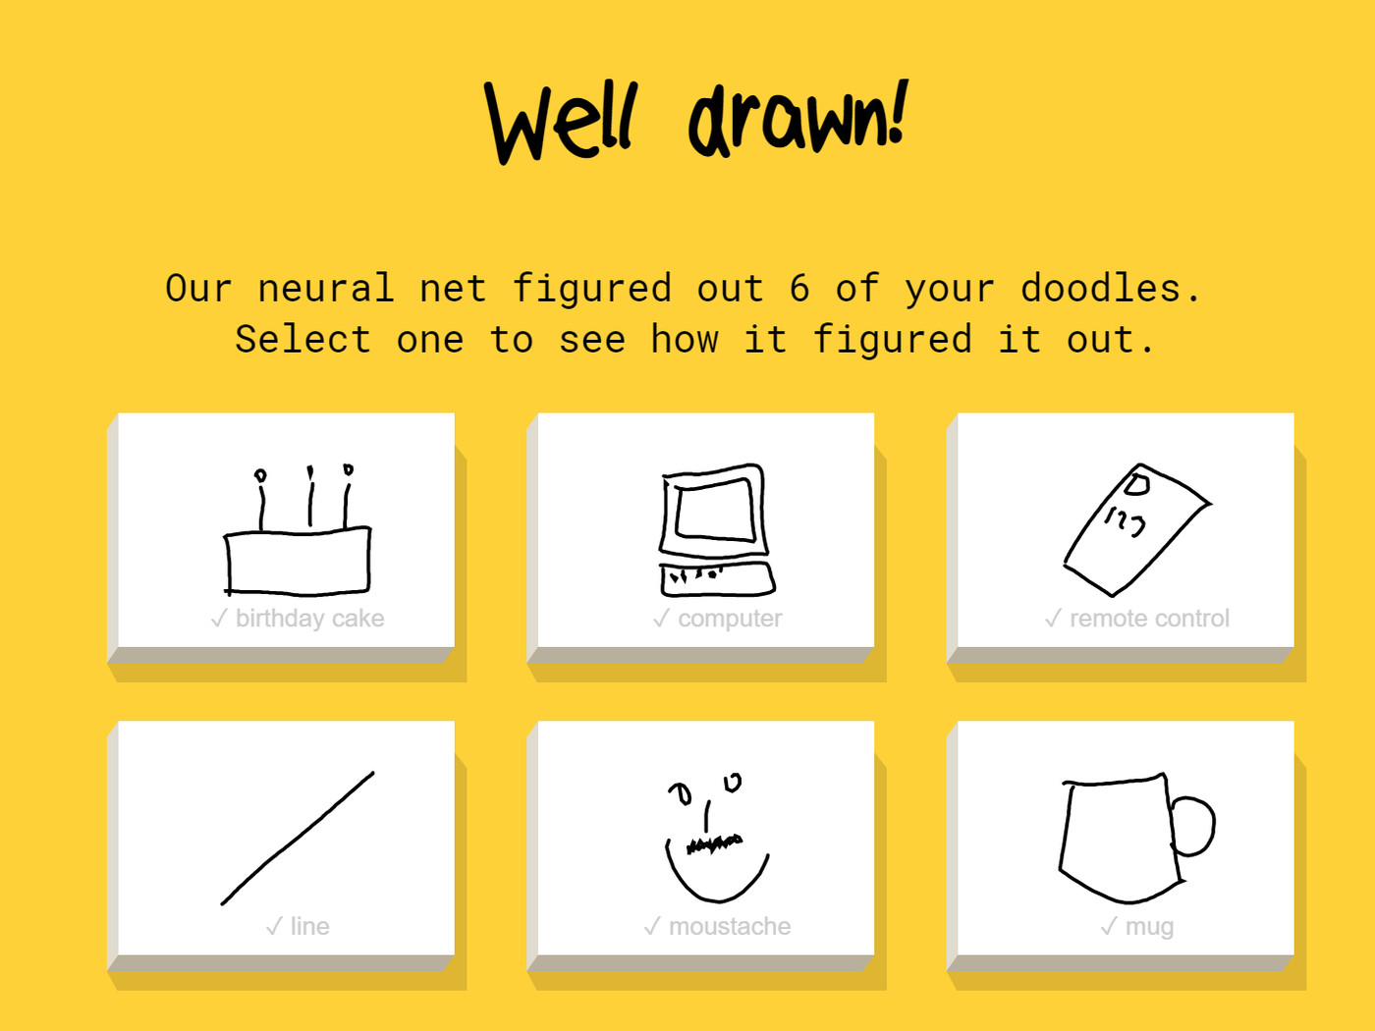
Introduction
In 2016, Google released an online game titled “Quick, Draw!” — an AI experiment that has educated the public on neural networks and built an enormous dataset of over a billion drawings.
Applications:
Invent new games / business ideas
Improving handwriting recognition
In this project, will train some categories of Google public dataset to make Quick Draw Recognition web app.

Slide 4
TEFPA
Task: Classify draw image to correspond category.
Experience: Label image as correspond category.
Function Space:
Performance: Cross Entropy Loss.
Algorithm: CNN.

Slide 5
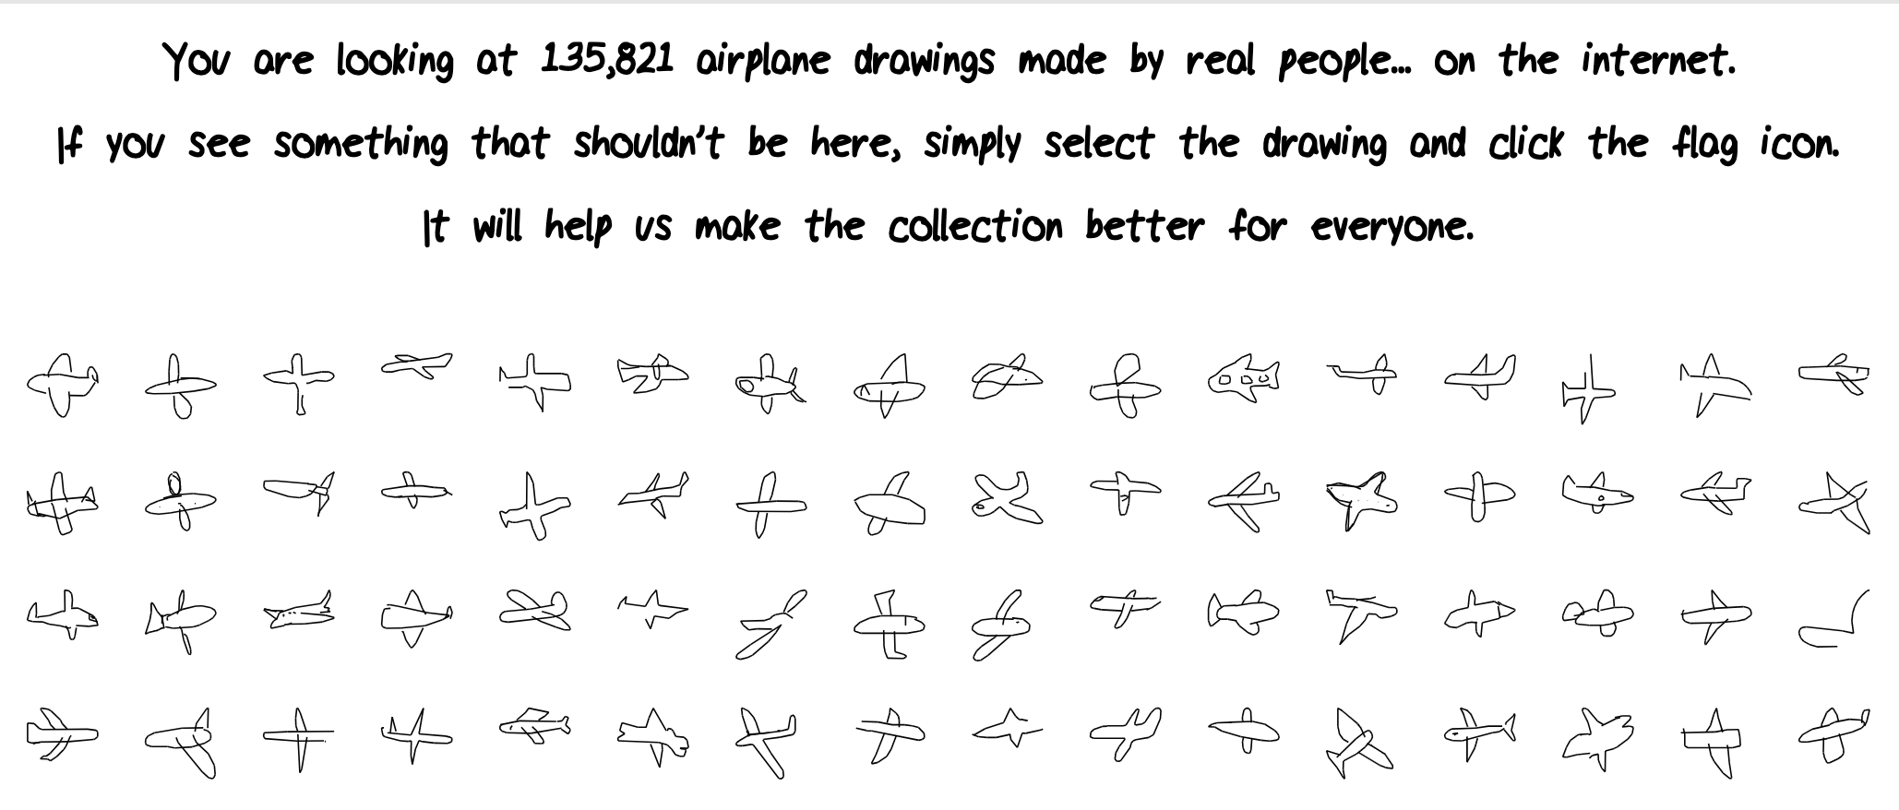
Dataset
Access by API:
https://cloud.google.com/storage/docs/access-public-data
Download file:
https://console.cloud.google.com/storage/browser/quickdraw_dataset/full/numpy_bitmap/

Slide 6
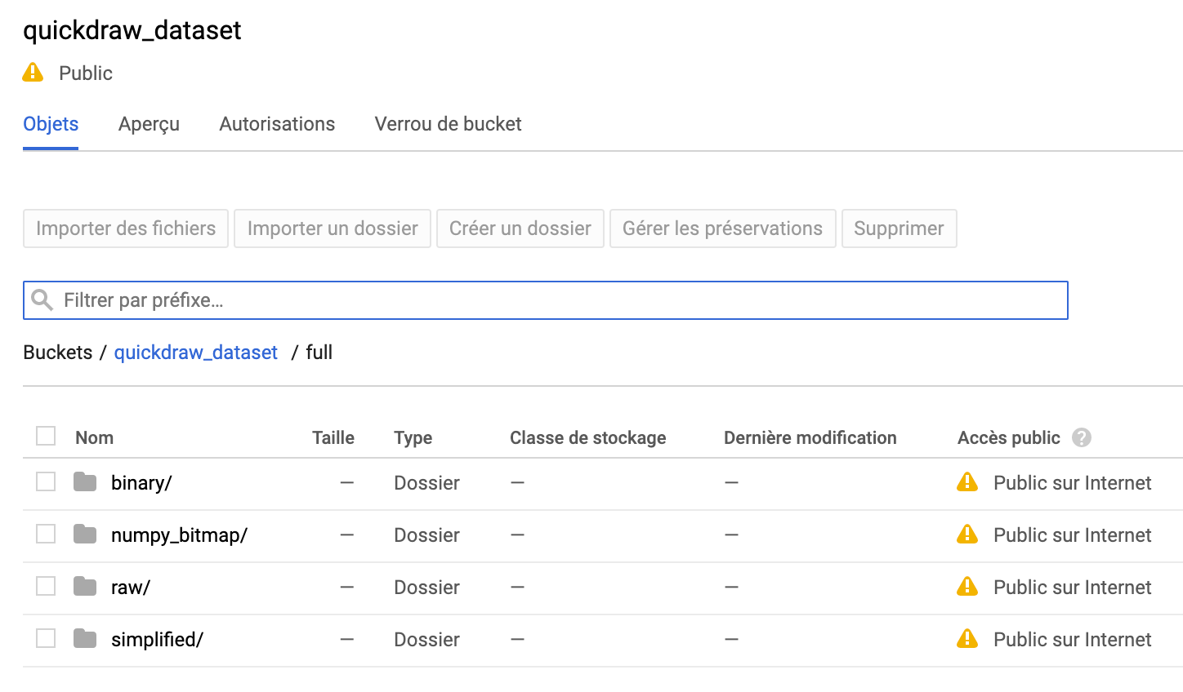
Dataset
Data types:
ndjson: a sequence of strokes of points in x, y, and n, where n indicates whether a the point is the first point in a new stroke
numpy_bitmap: each category is 2d array with size nx784
Data properties:
50M drawings
345 categories.
73GB

Slide 7
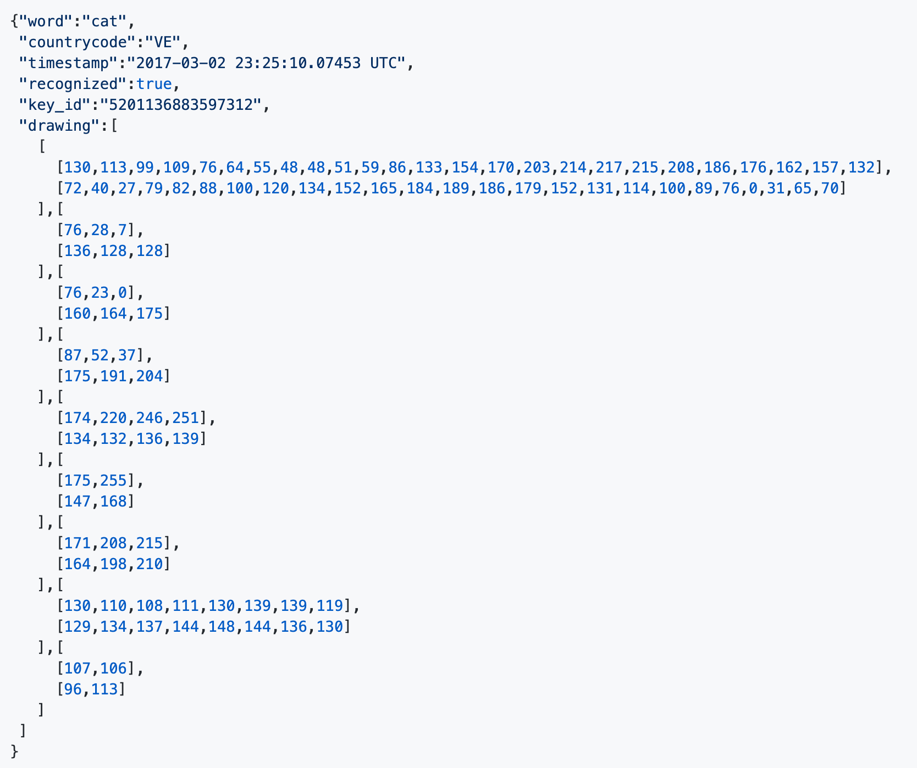
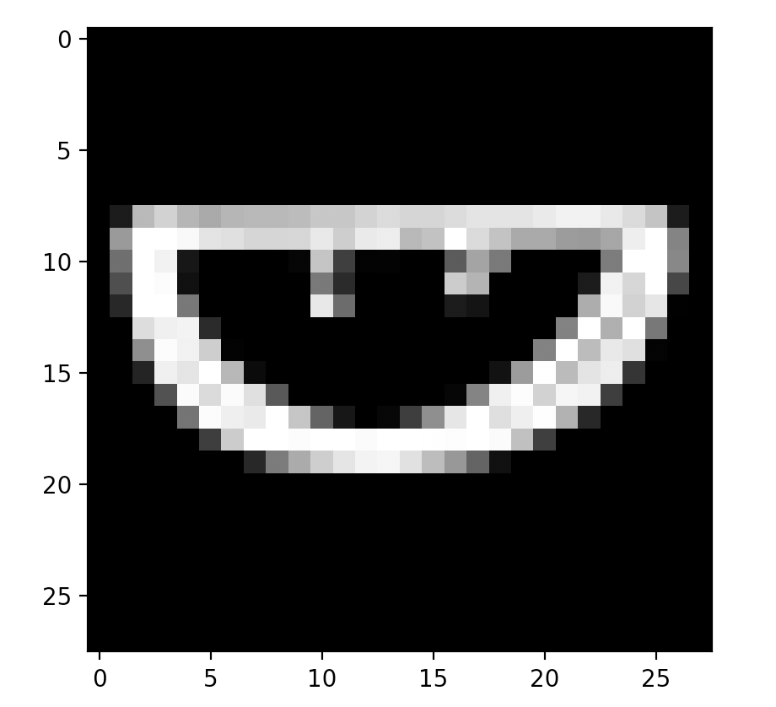
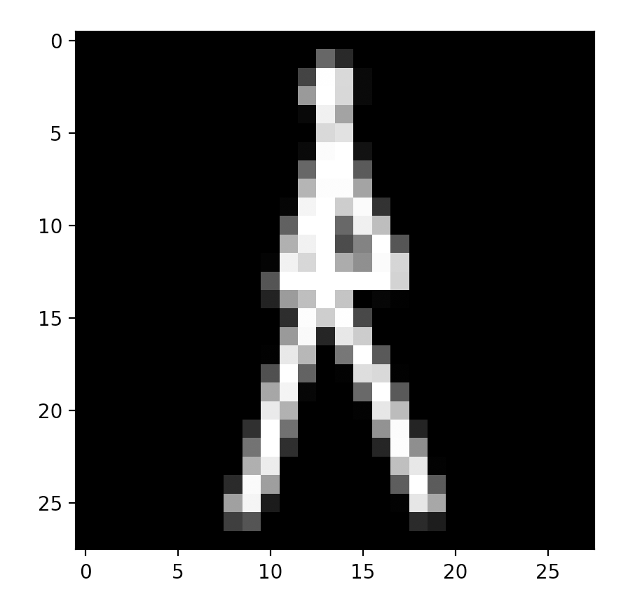
Dataset
Watermelon
(28x28)
Eiffel Tower
(28x28)
ndjson
numpy bitmap

Slide 8
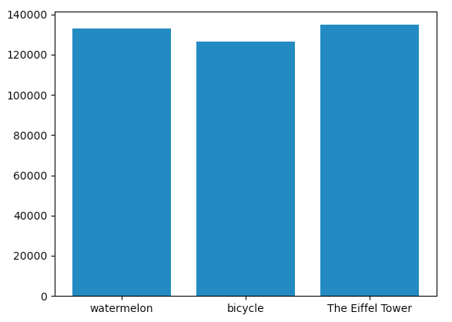
Dataset
Data for project
Object name | Image count
watermelon | 132,939
bicycle | 126,527
The Eiffel Tower | 134,801

Slide 9
Models
Tensorflow Keras Sequential API.
Structures:
Convolutional (Conv2D) layer.
It is like a set of learnable filters
32 filters for the two firsts conv2D layers
64 filters for the two last ones.
Pooling (MaxPool2D) layer:
acts as a downsampling filter.
picks the maximal value 2 neighboring pixels.
reduce computational cost
reduce overfitting.
more the pooling dimension is high, more the downsampling is important.
Dropout:
randomly ignored for each training sample.
drops randomly a propotion of the network
forces the network to learn features in a distributed way.

Slide 10
Models
2. Structures (continue):
Relu:
Used to add non linearity to the network.
Flatten layer:
Convert the final feature maps into a one single 1D vector.
Last two fully-connected (Dense) layers:
In the last layer outputs distribution of probability of each class.

Slide 11
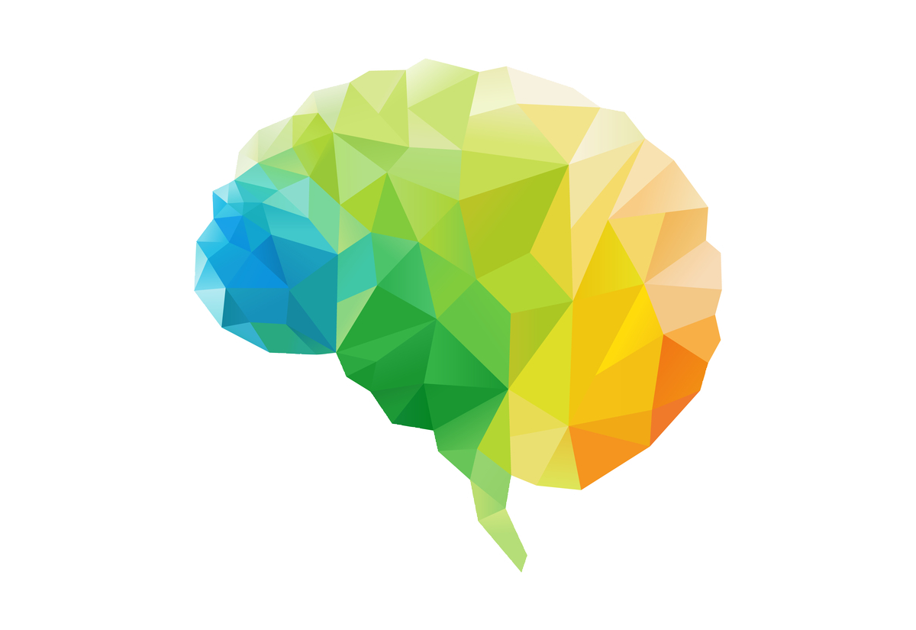
Models
Train parameters:
Epochs: 30
Batch size: 64
Optimizer: Adam
Learning rate: 0.001
Call backs:
Log history
Save weight:
save the best only
monitor=loss

Slide 12
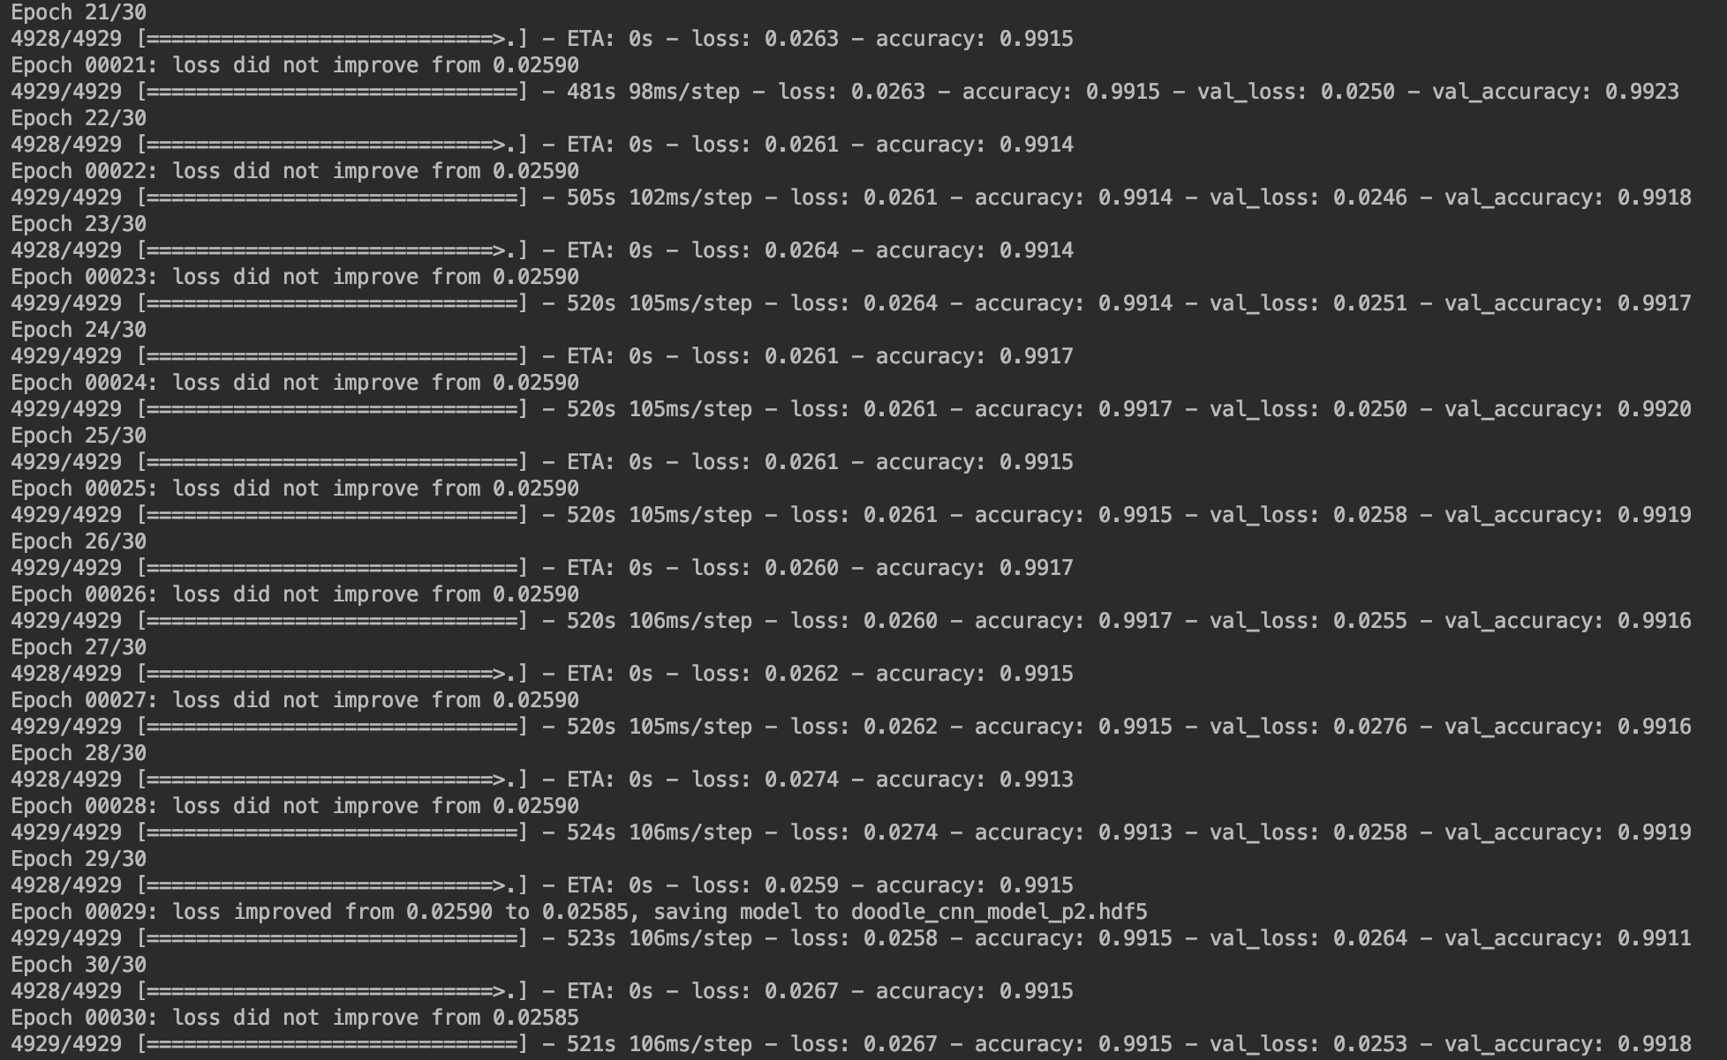
Training History
Train the model:
python train.py
All trained weights will saved to:
saved/*.hdf5
All history will saved to:
saved/training.log

Slide 13
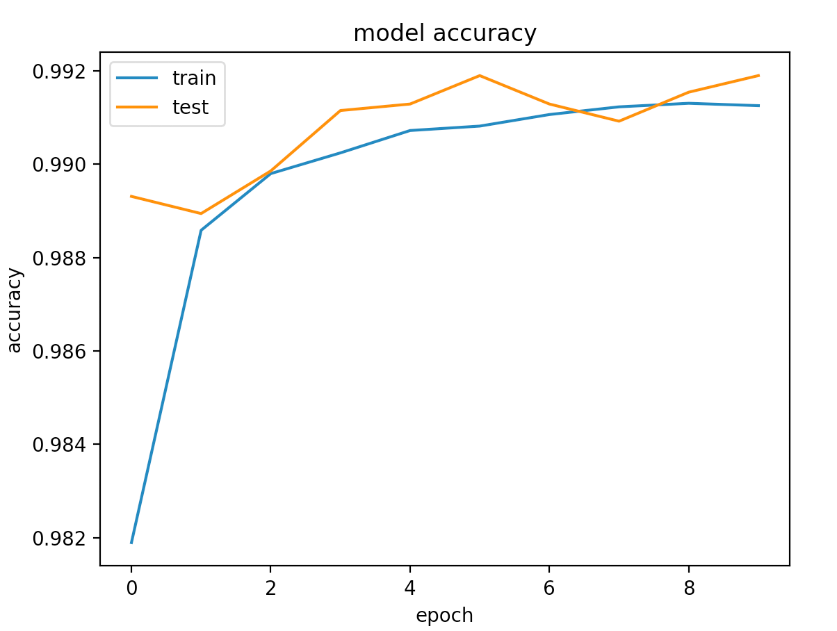
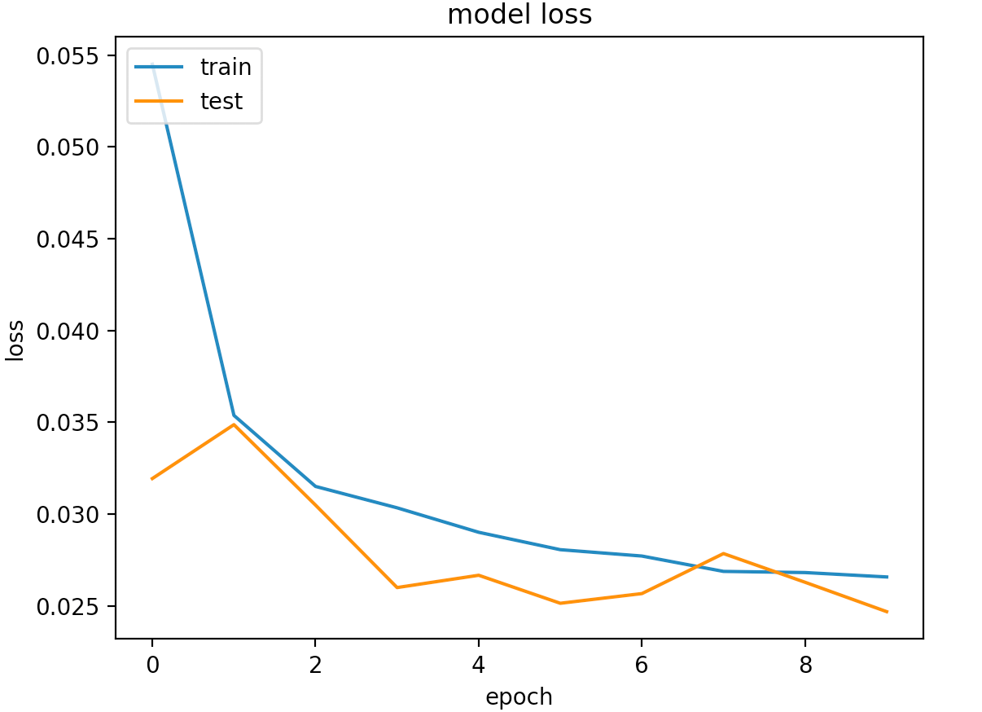
Training History

Slide 14
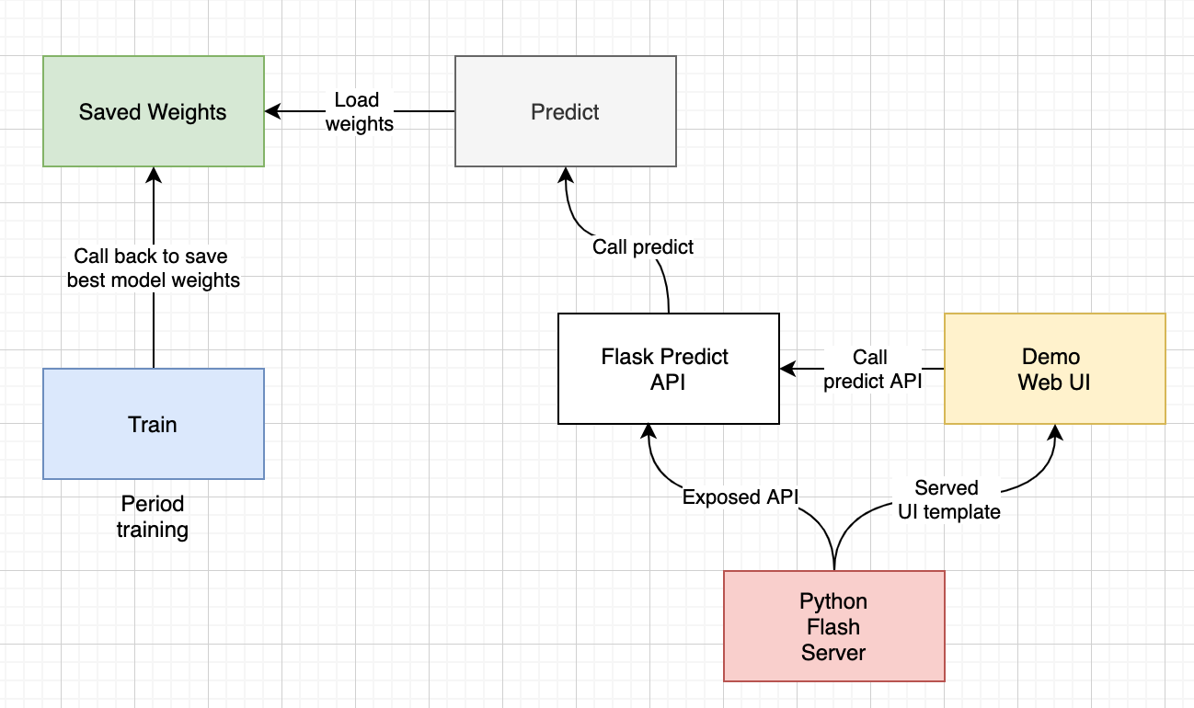
Demo

Slide 15
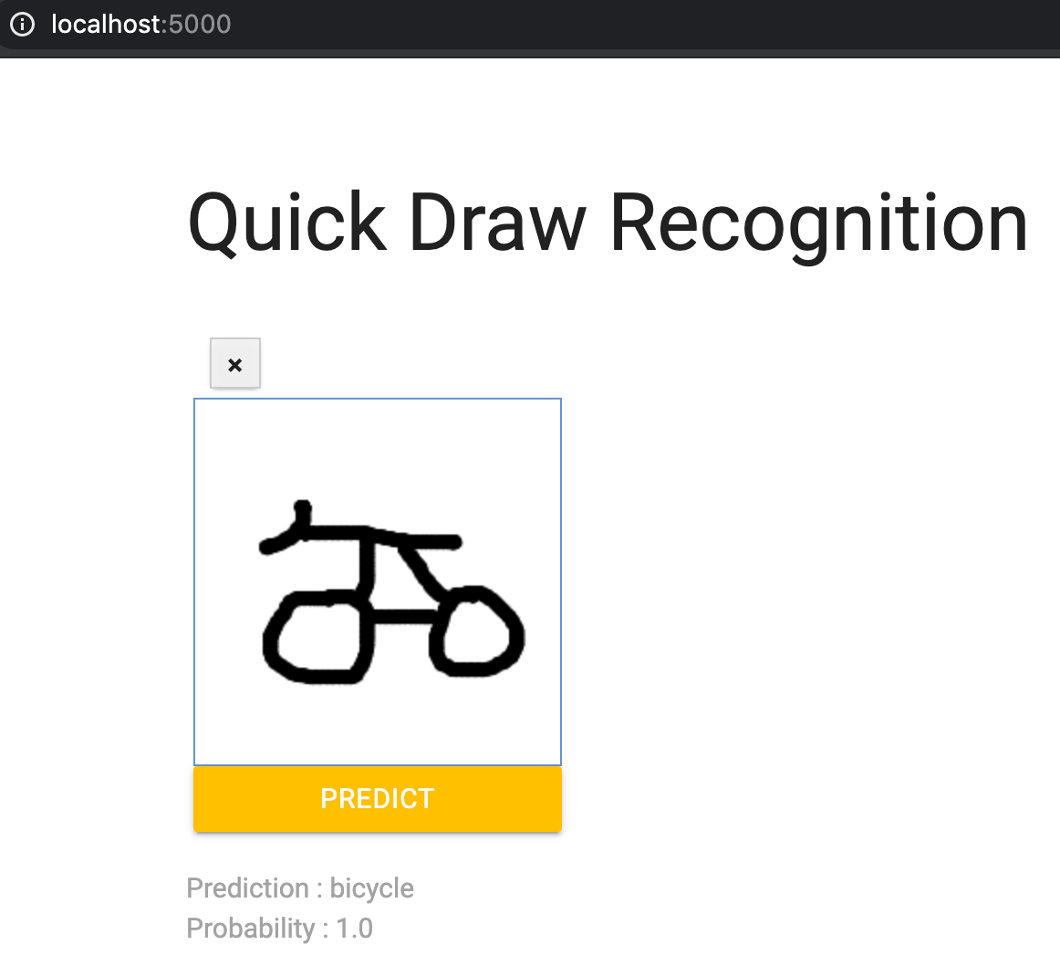
Demo
1. Draw an object on the right board
2. Click the Predict button
3. Results will be showed
(You can repeat these steps with the
clear button)

Slide 16


Slide 17
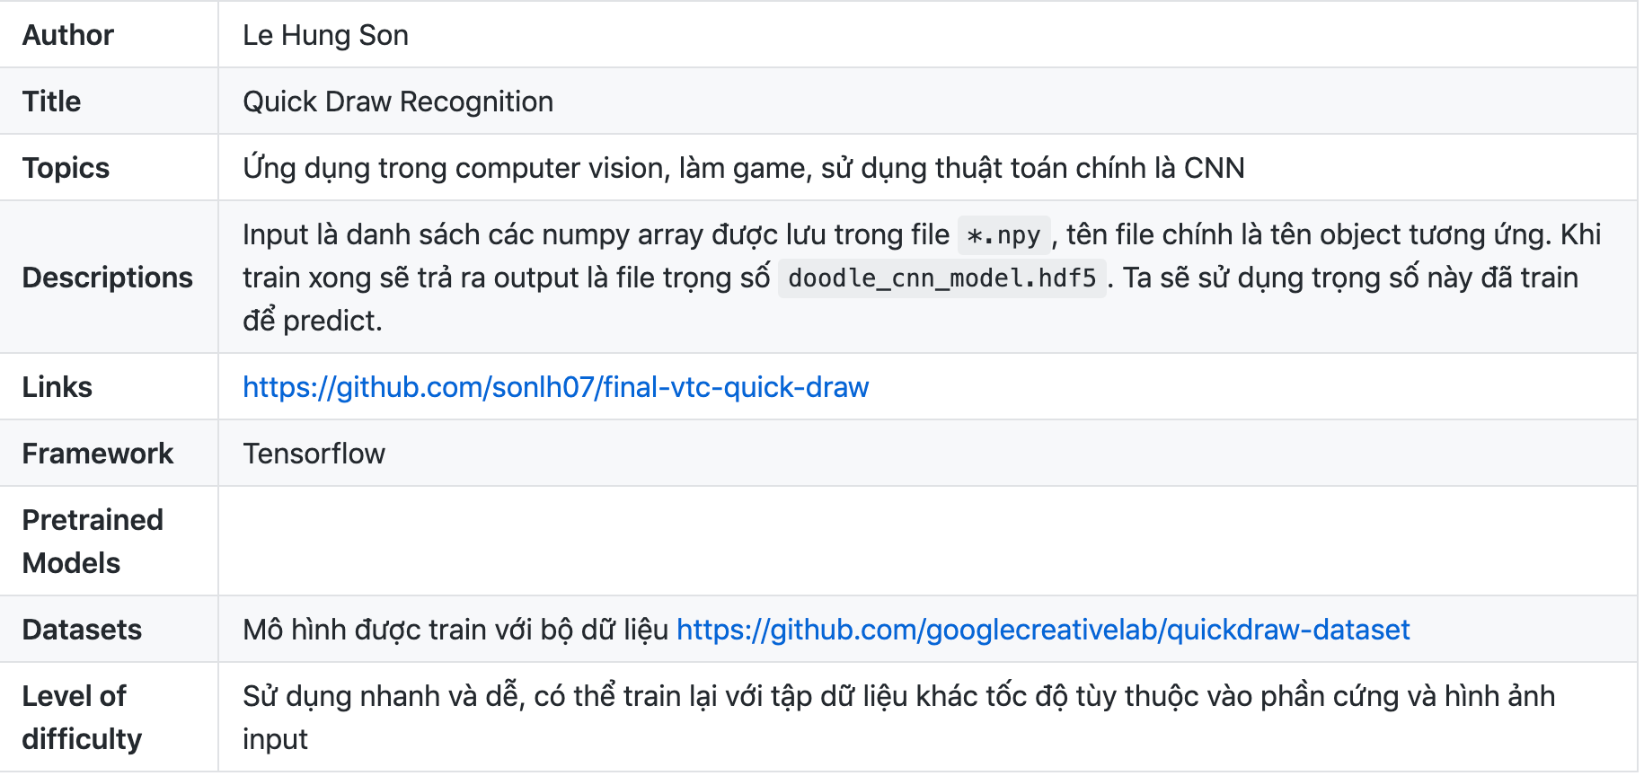
Project Summary
Github: https://github.com/sonlh07/final-vtc-quick-draw
Summary:

Slide 18
References
Dataset:
https://github.com/googlecreativelab/quickdraw-dataset#get-the-data
The way you draw:
https://qz.com/994486/the-way-you-draw-circles-says-a-lot-about-you/
Neuron:
https://github.com/lutzroeder/netron
Demo MNIST
https://github.com/gary30404/convolutional-neural-network-from-scratch-python/

